Slide 1


Slide 2
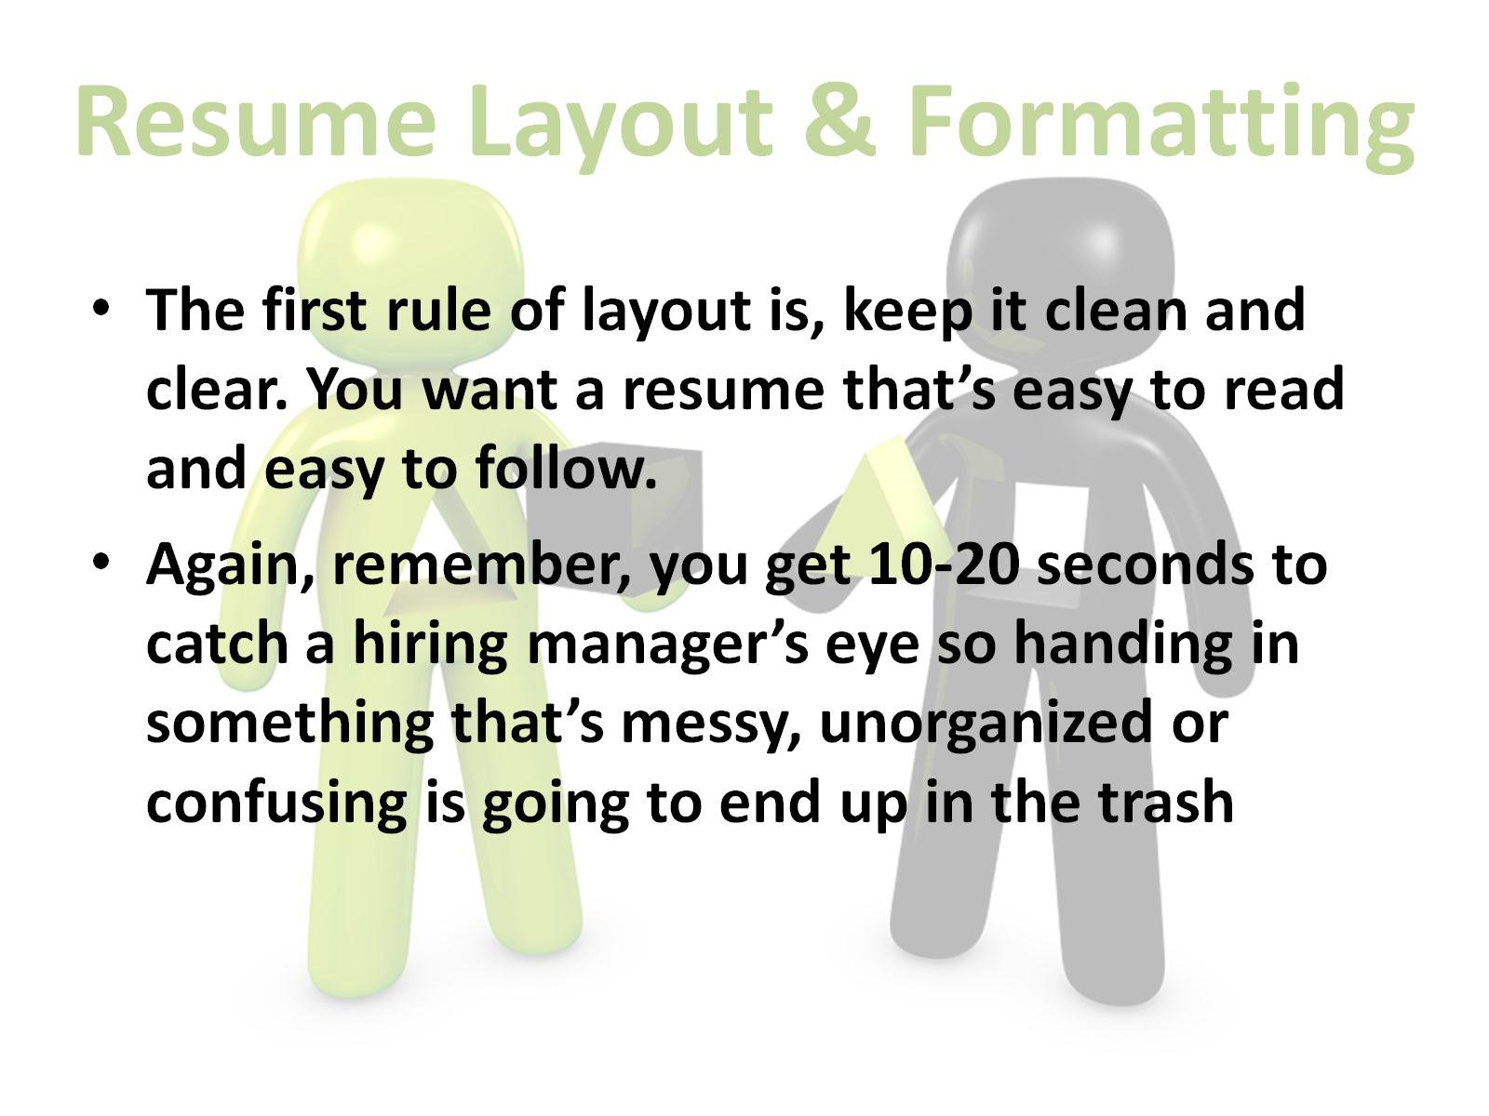
Resume Layout & Formatting

Slide 3
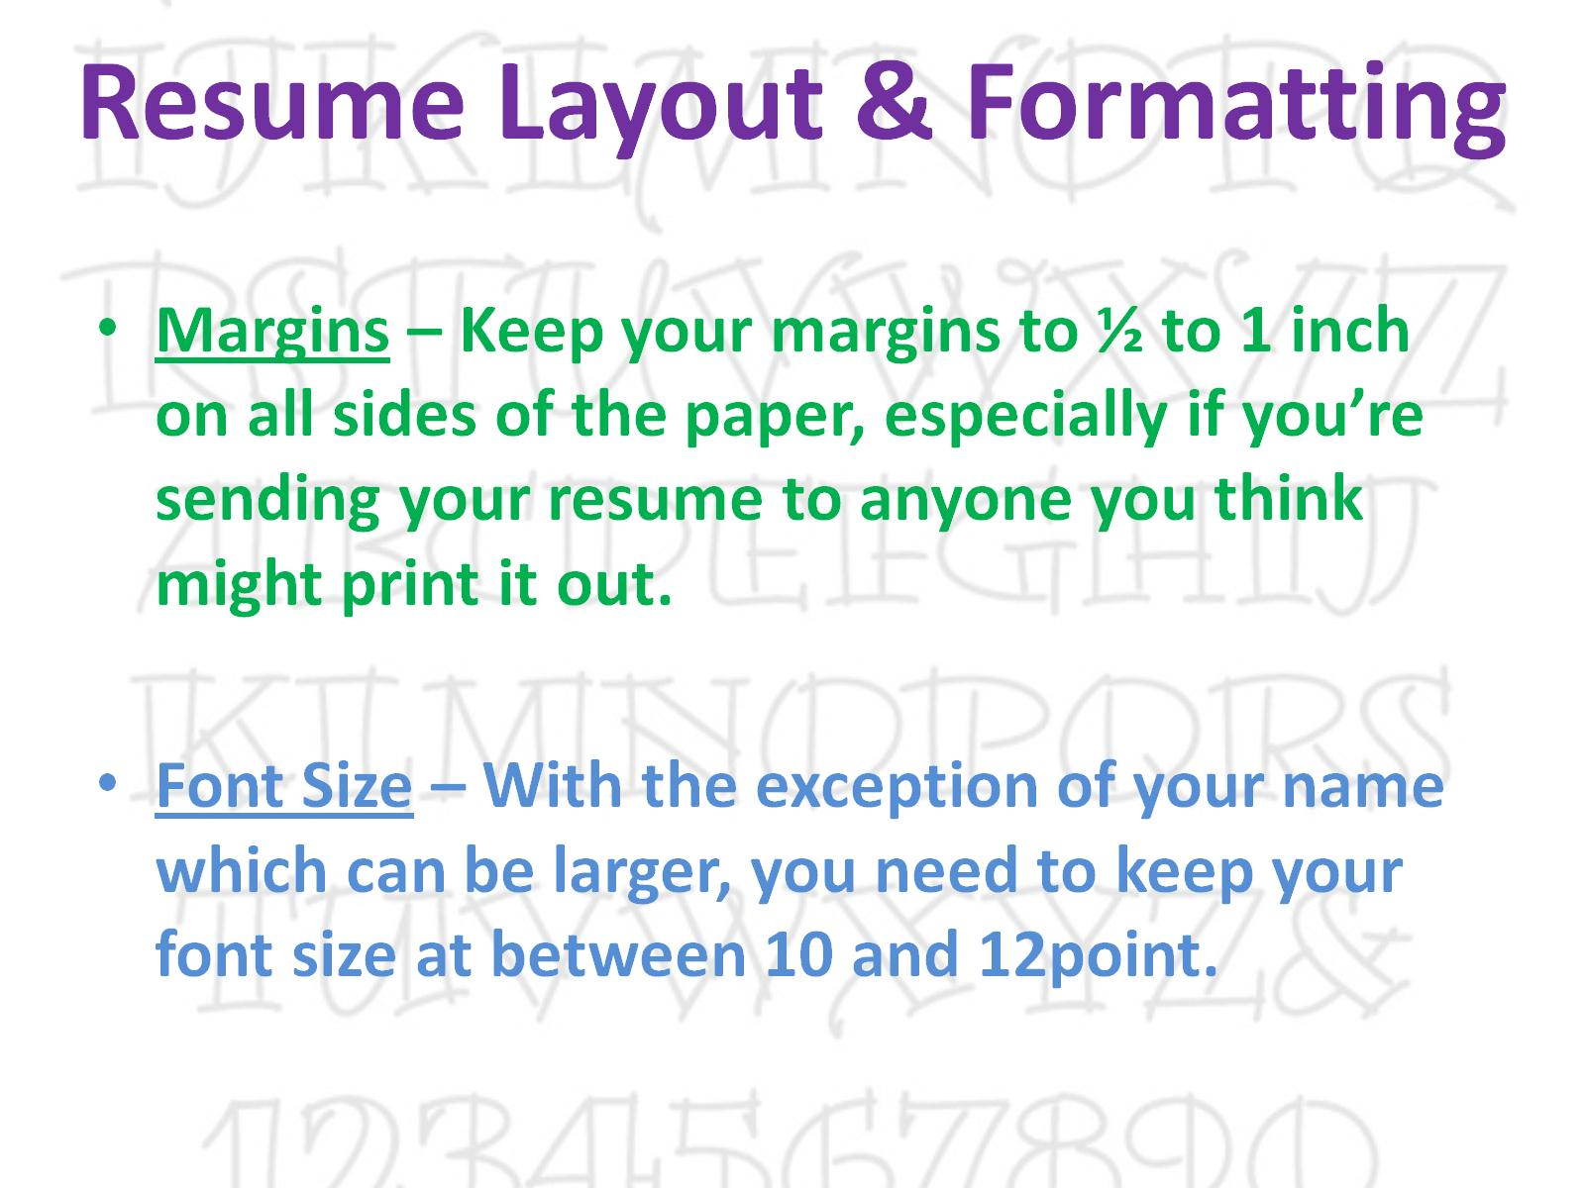
Resume Layout & Formatting

Slide 4
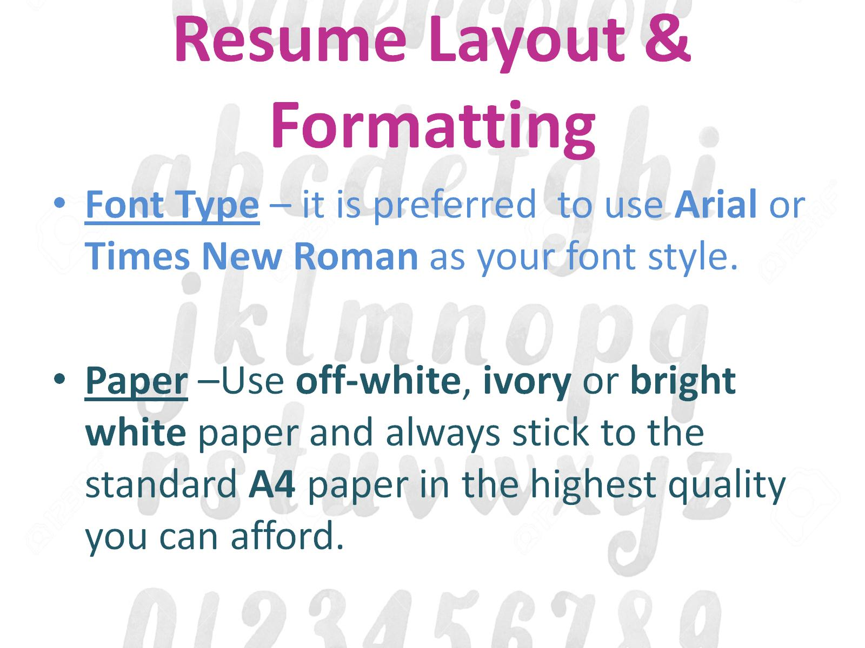
Resume Layout & Formatting

Slide 5
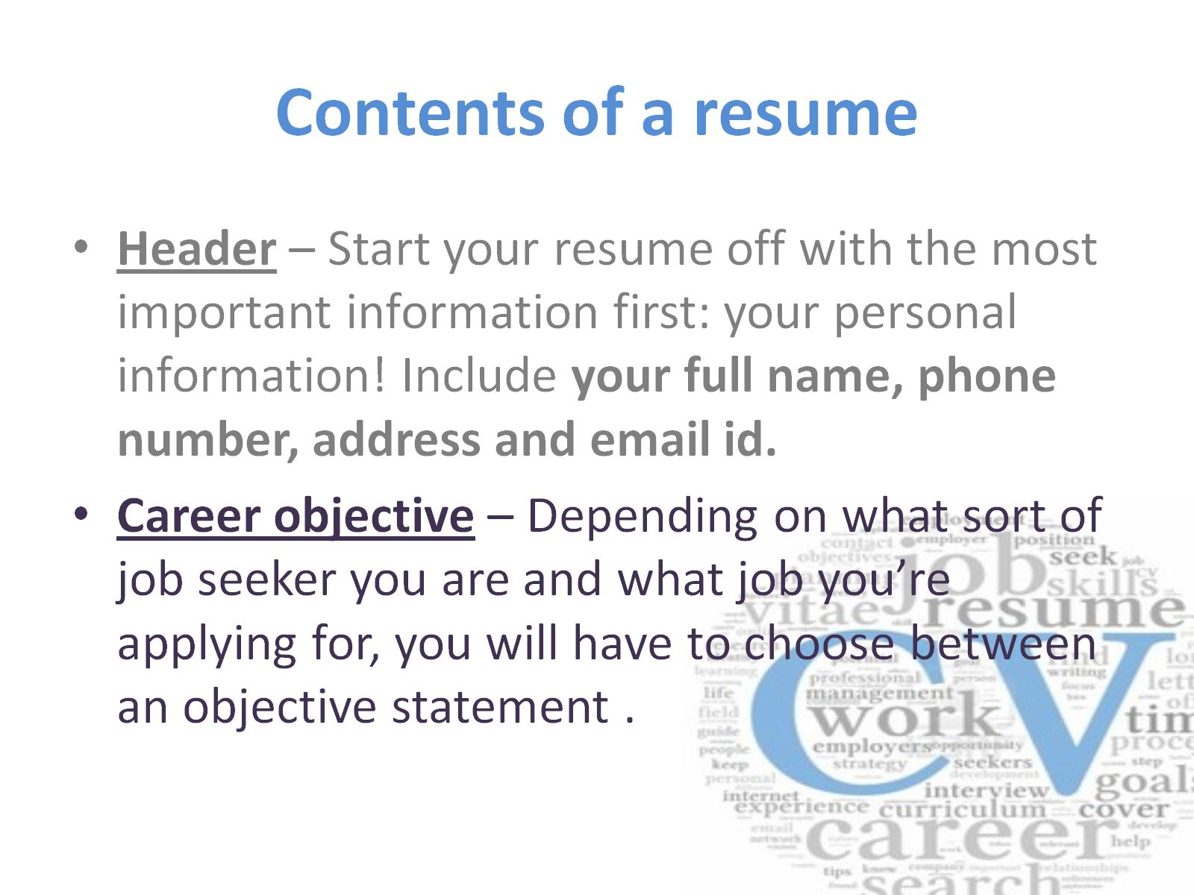
Contents of a resume

Slide 6
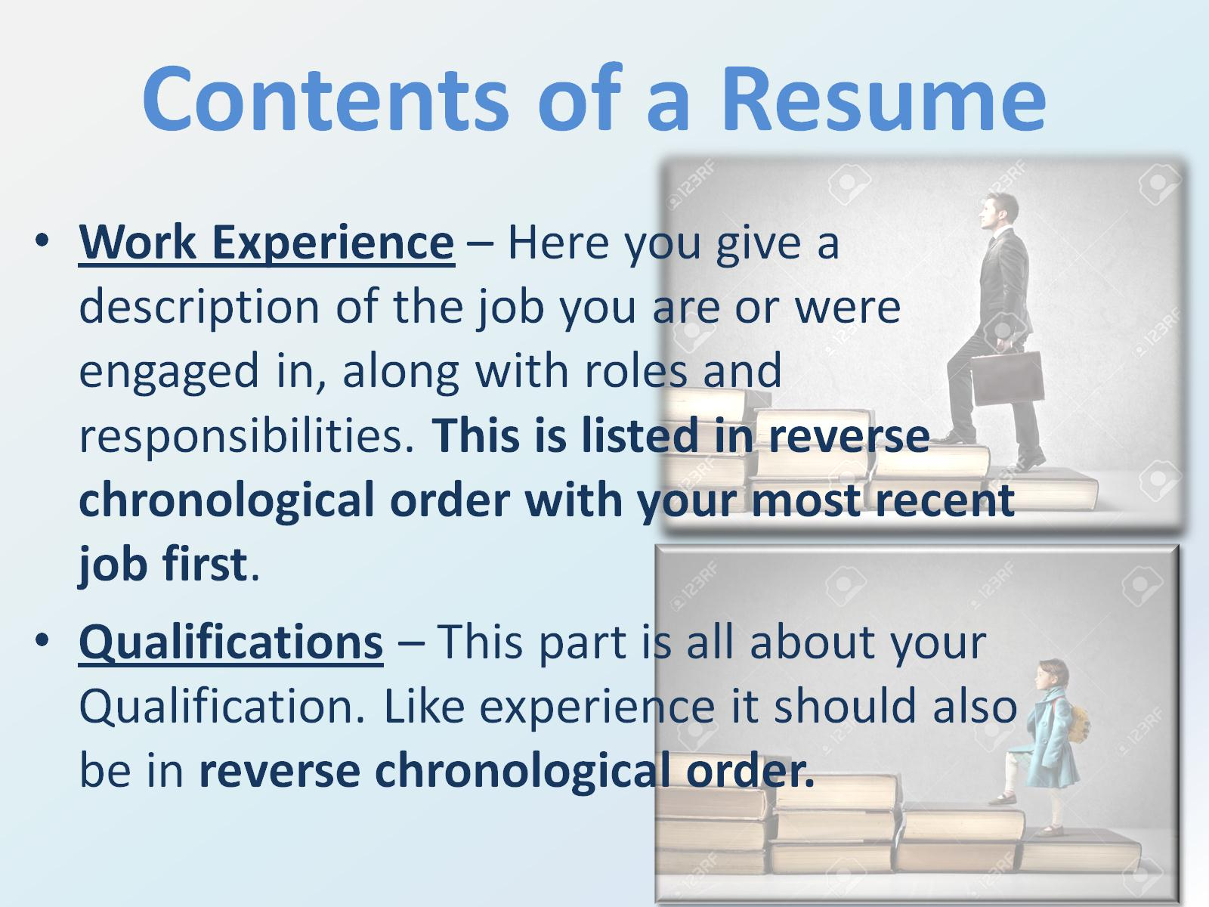
Contents of a Resume

Slide 7
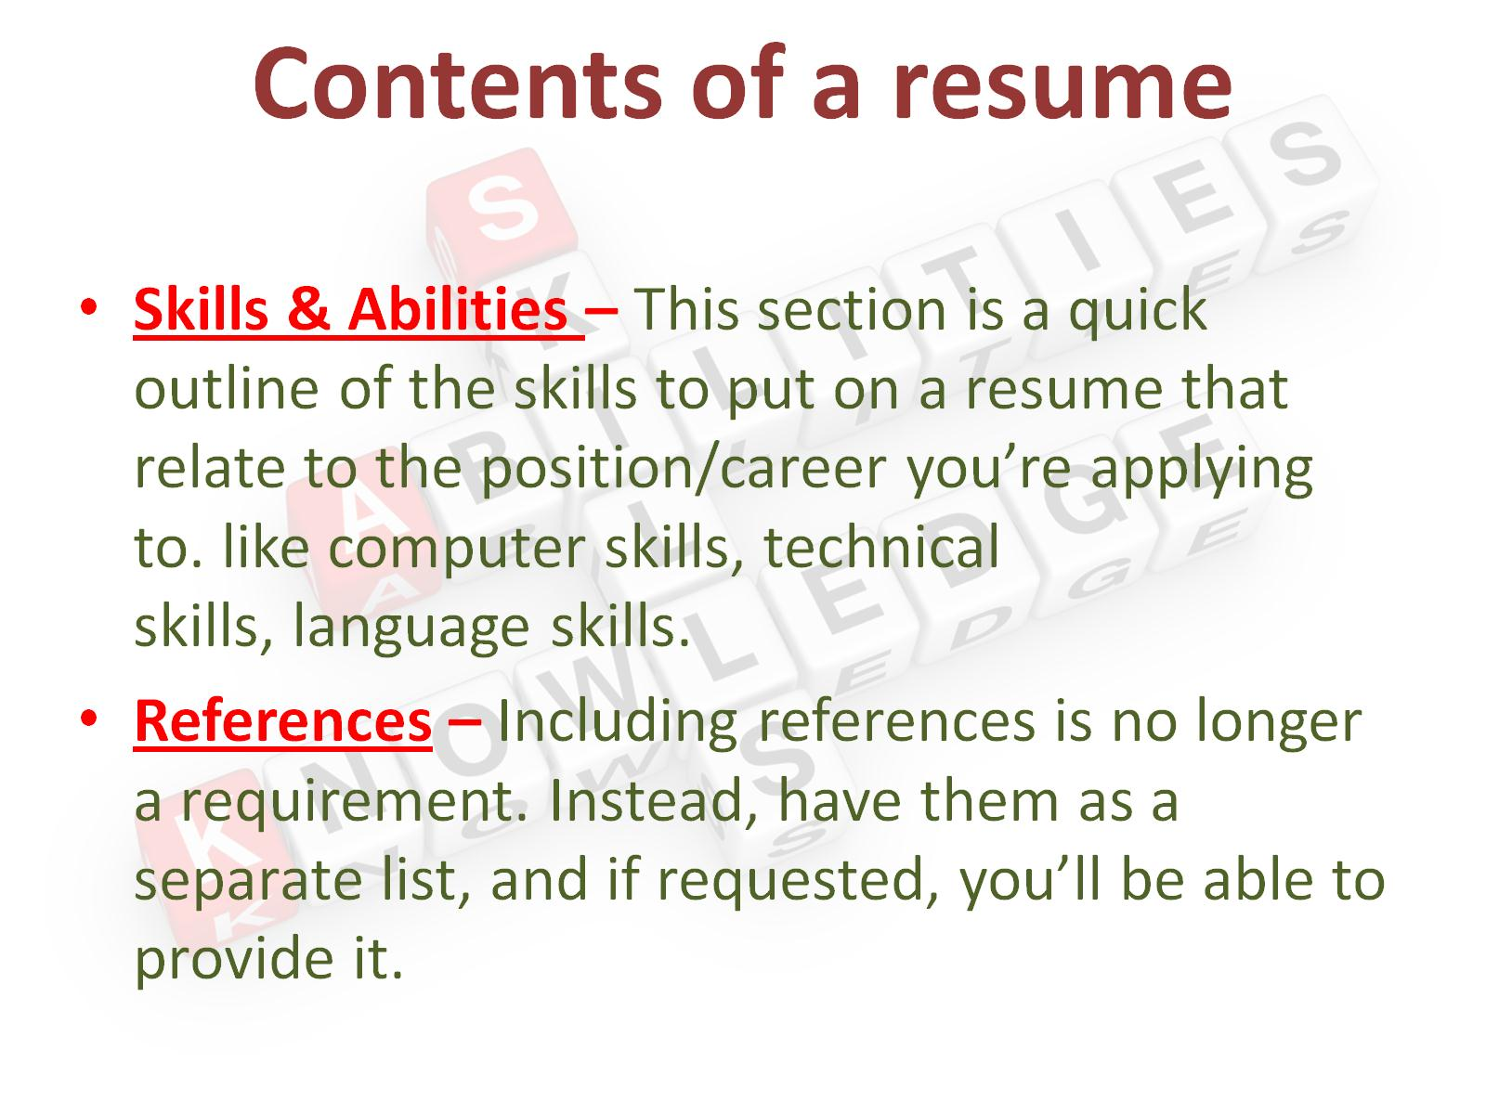
Contents of a resume

Slide 8
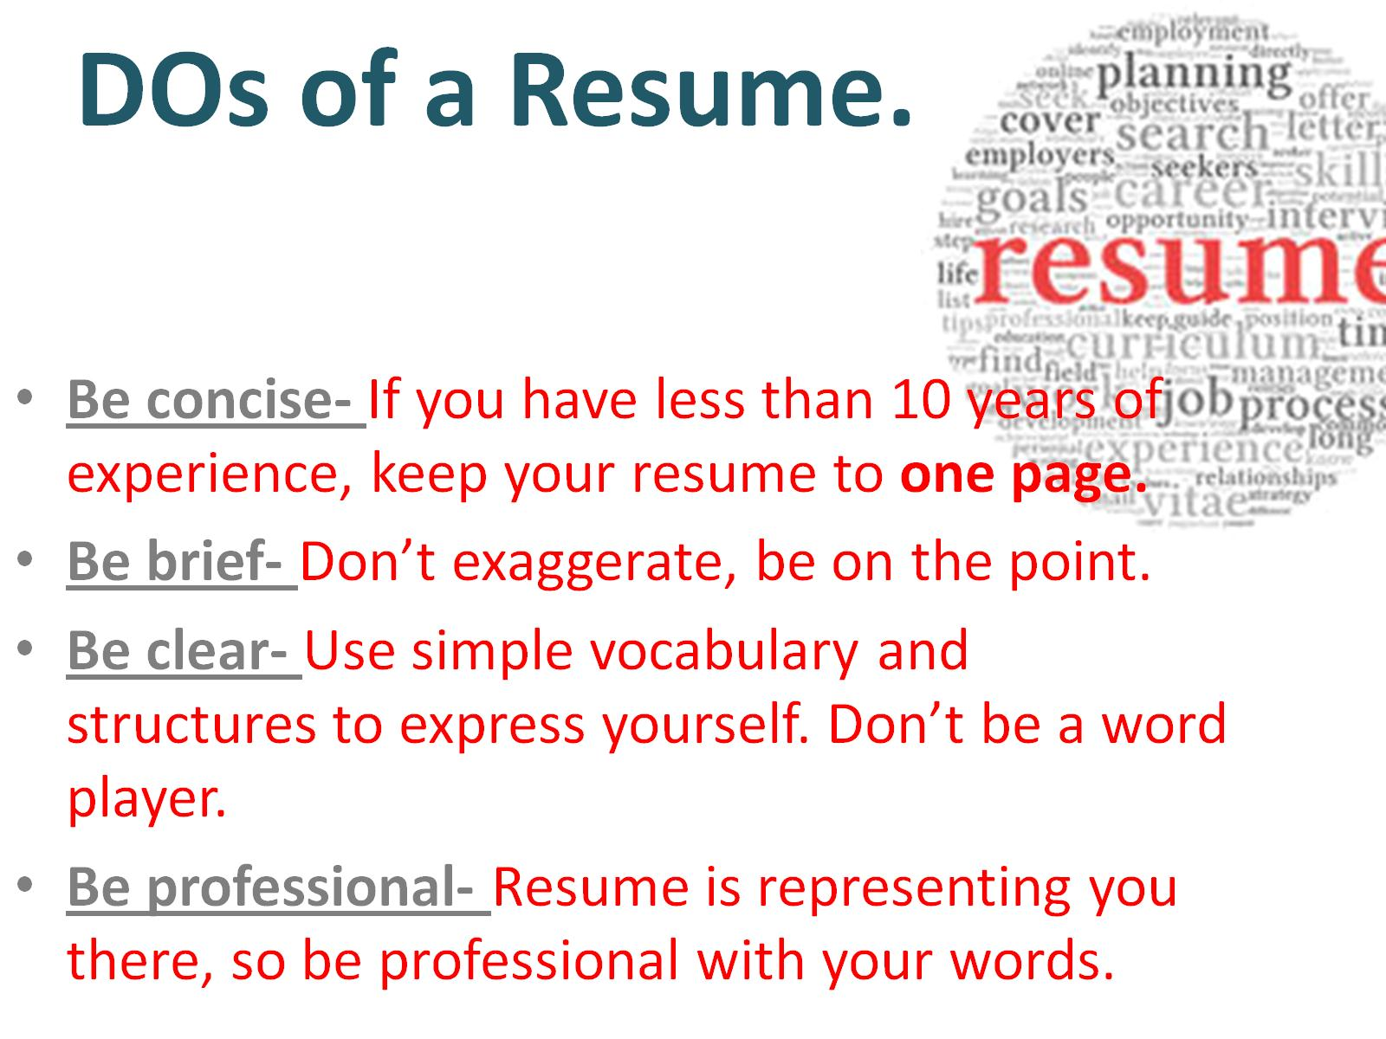
DOs of a Resume.

Slide 9
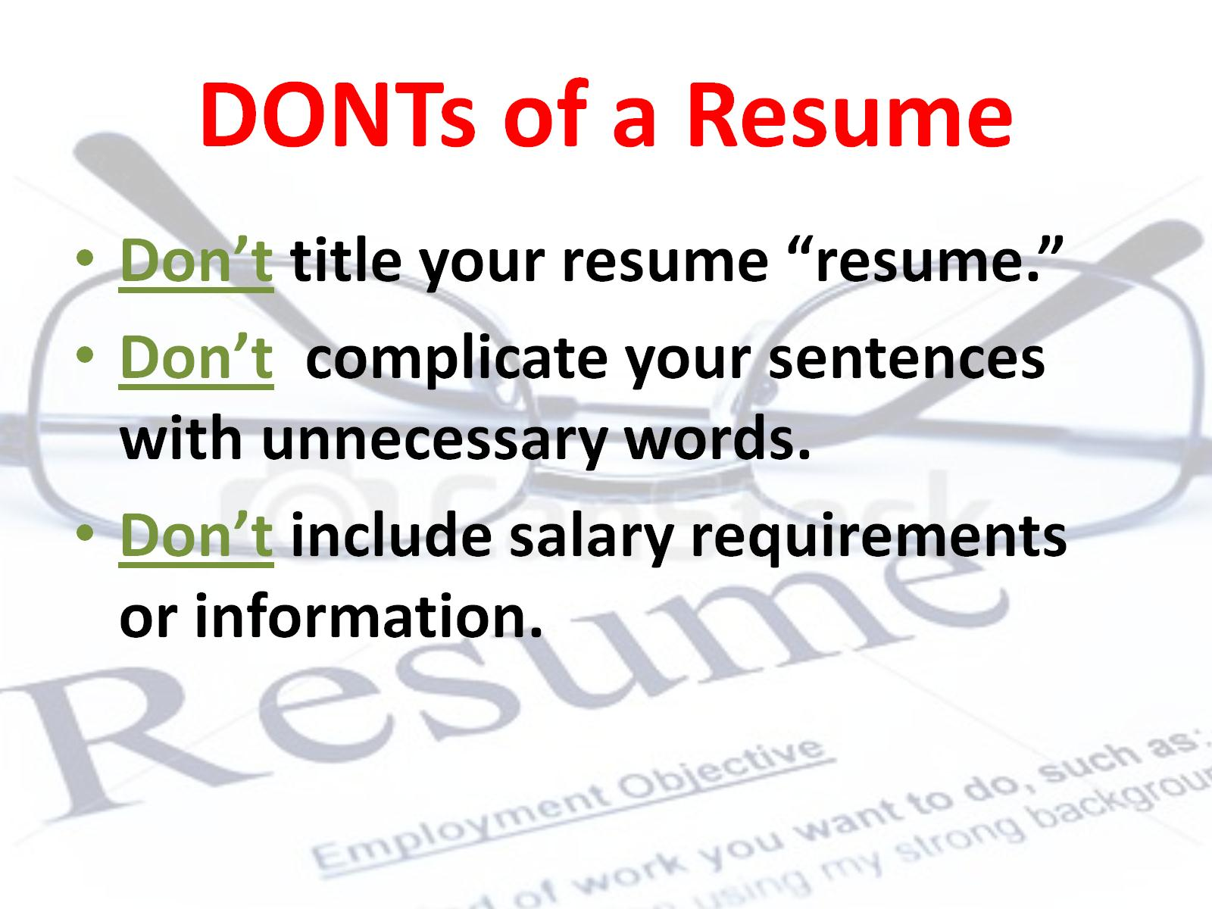
DONTs of a Resume

Slide 10
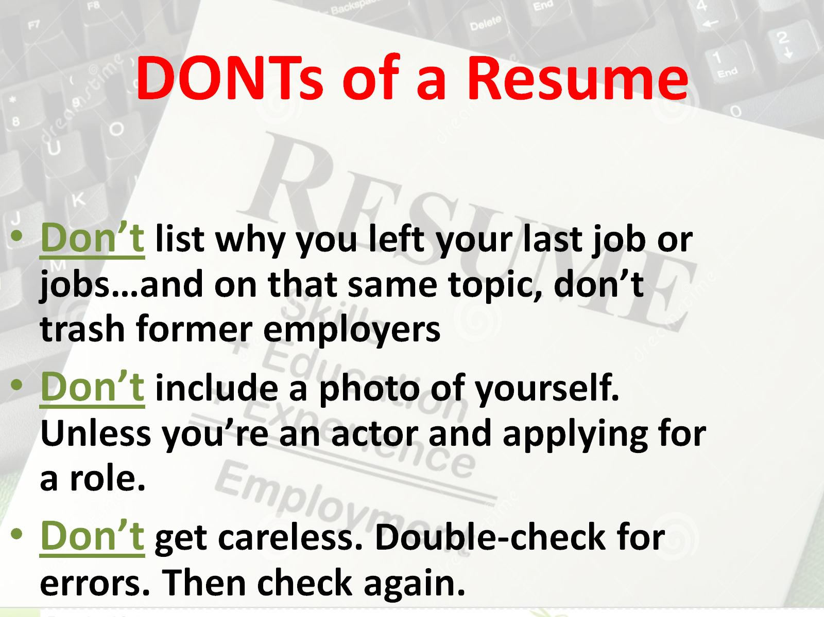
DONTs of a Resume

Slide 11
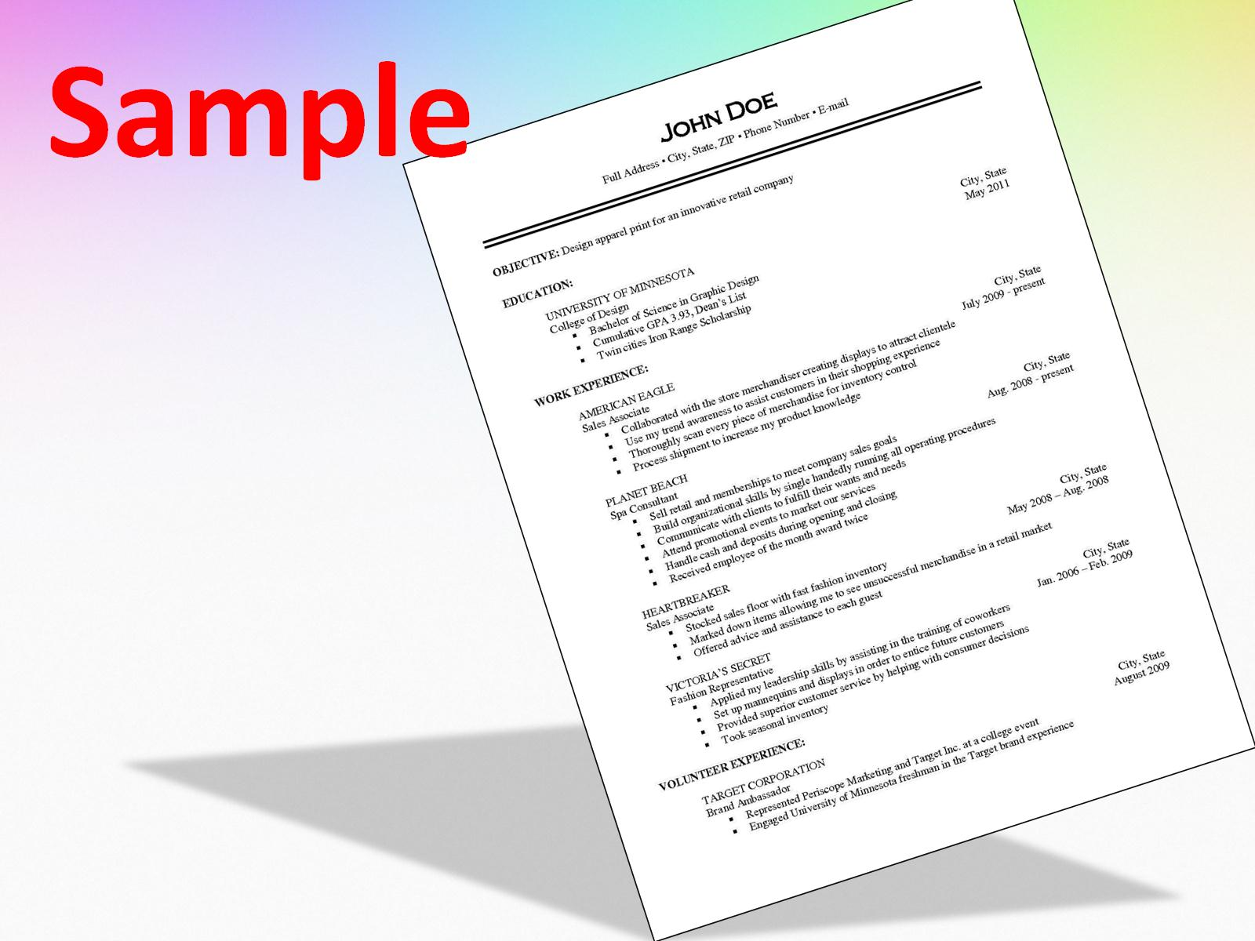
Sample

Slide 12


